Slide 1

FOREIGN DIRECT INVESTMENT DATA ANALYSIS
By
Chethan G S

Slide 2
Objective
To analyze the performance of different sectors over the years from 2000 to 2005.

Slide 3
PROBLEM STATEMENT
Investment is a game of understanding historic data of investment objects under
different events but it is still a game of chances to minimize the risk we apply analytics
to find the equilibrium investment.
To understand the Foreign direct investment in India for the last 17 years from 2000-01
to 2016-17. This dataset contains sector and financial year-wise data of FDI in India
Sector-wise investment analysis Year-wise investment analysis.
Find key metrics and factors and show the meaningful relationships between
attributes. Do your own research and come up with your finding

Slide 4
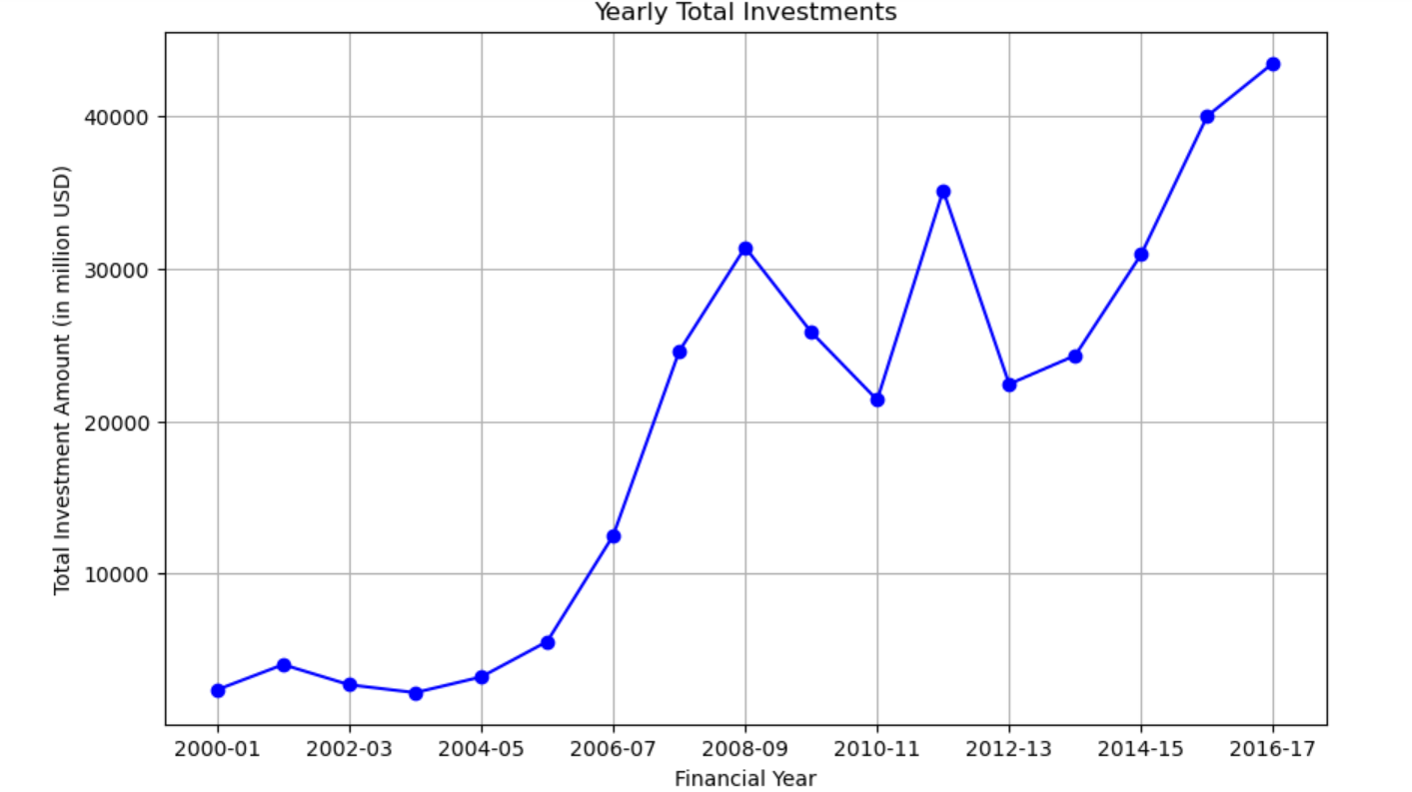
INSIGHTS
The line plot shows a significant increase in total FDI in India from 2004-05 to 2008-09, followed by some fluctuations. After a dip around 2012-13, investments have consistently risen, peaking in 2016-17. This indicates an overall positive trend in FDI over the analyzed period.

Slide 5
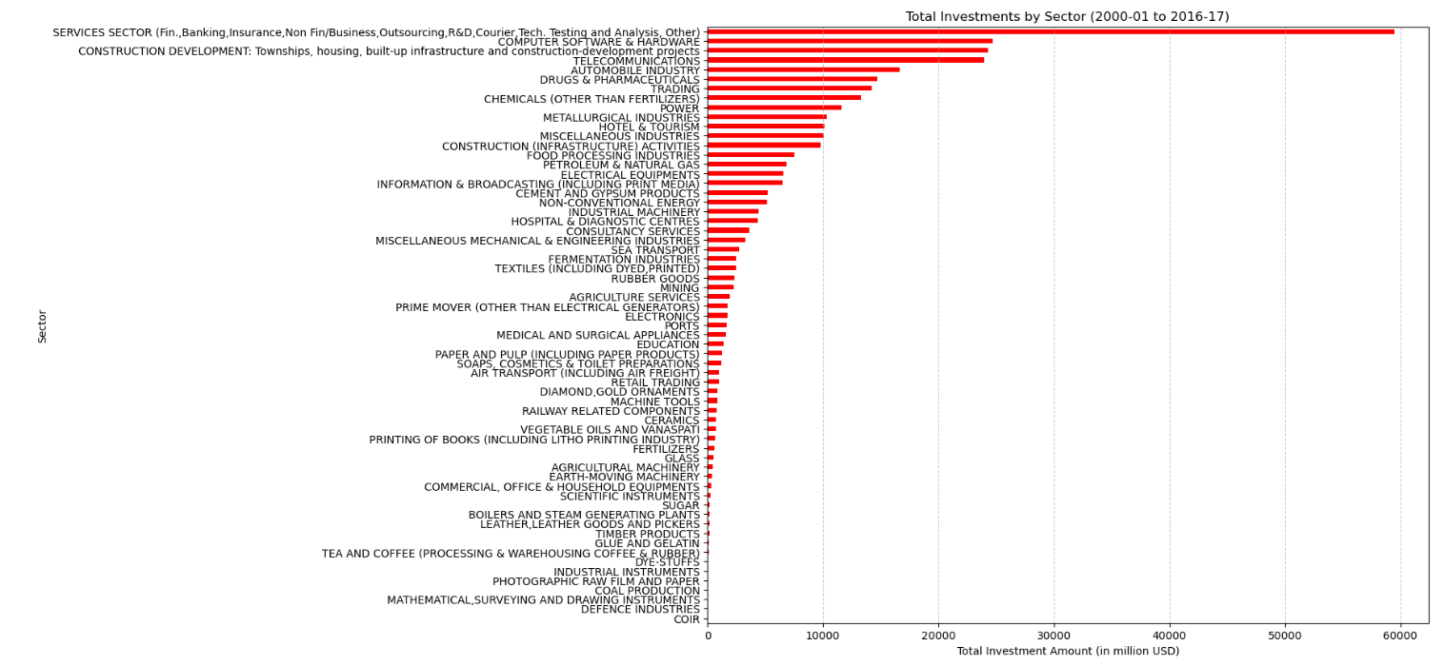

Slide 6
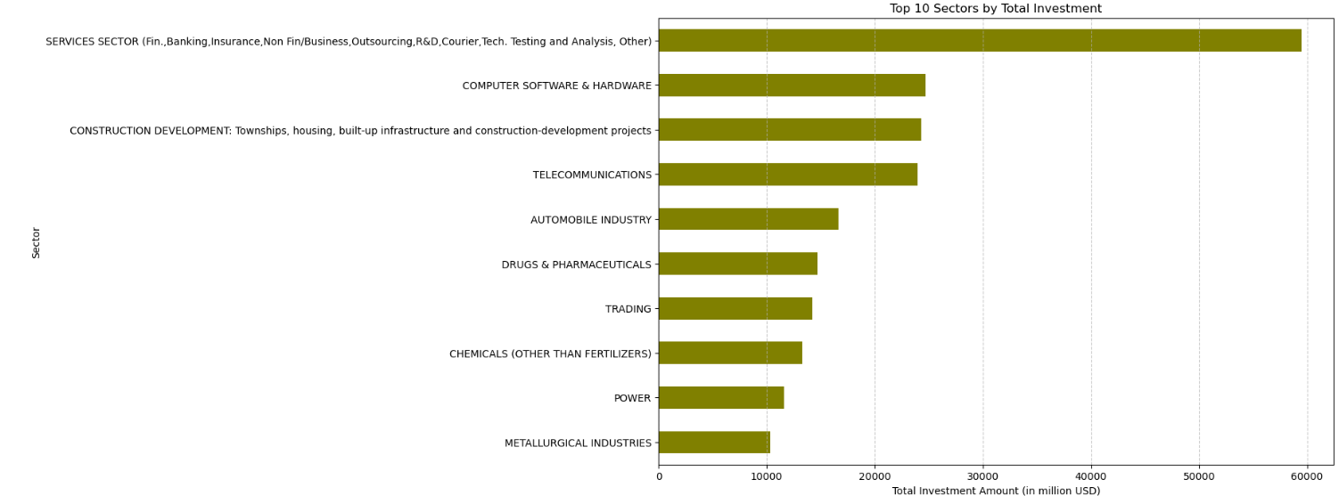
TOP 10 SECTORS BY INVESTMENT

Slide 7
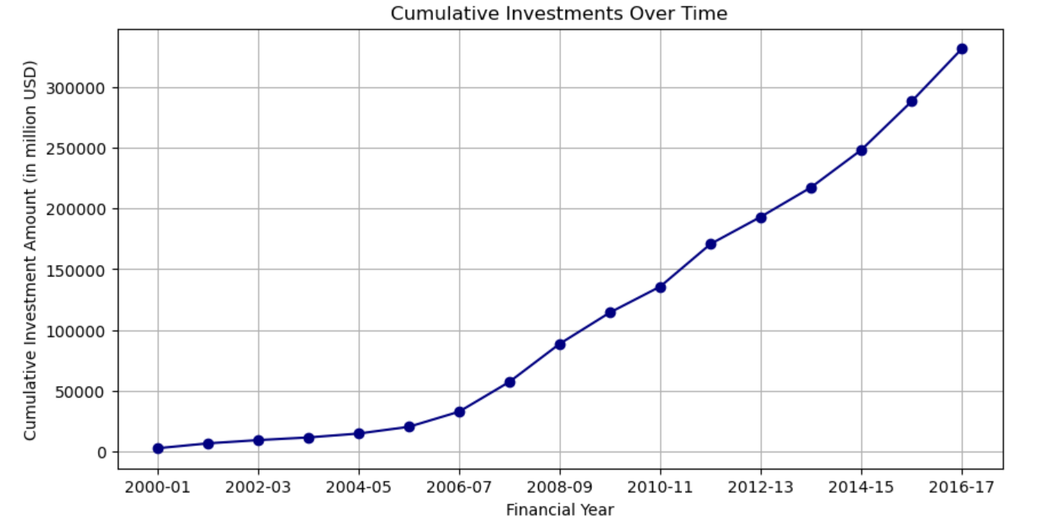

Slide 8
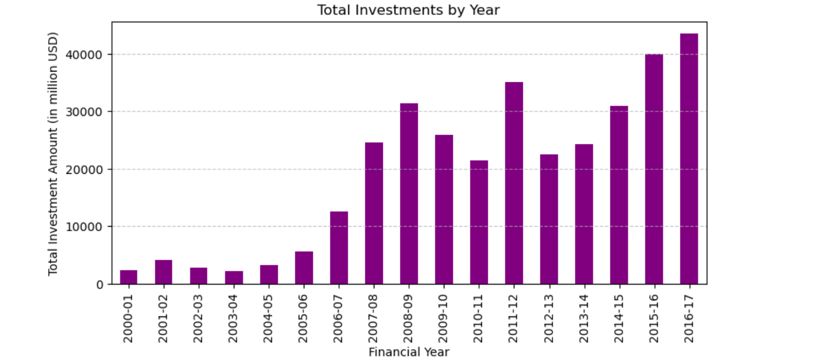

Slide 9
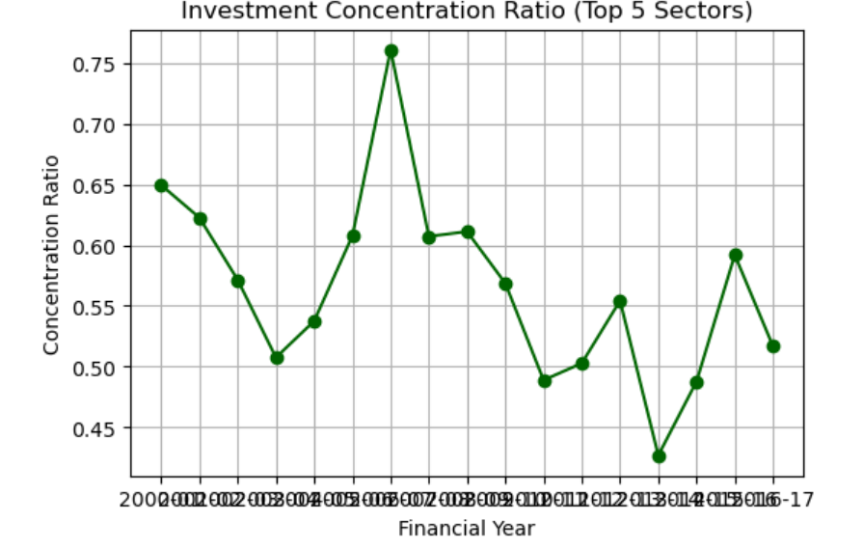
Investment Concentration Analysis

Slide 10
CONCLUSION
The analysis of the Investment Concentration Ratio over the years reveals fluctuations in how concentrated FDI investments have been within the top 5 sectors. The trend towards decreasing concentration in recent years indicates positive diversification, which should be further encouraged through targeted policies and incentives. Monitoring periods of high concentration and ensuring balanced growth across sectors will help in sustaining a robust and diversified economic environment attractive to foreign investors.

Slide 11
THANK YOU
CHETHAN G S

